Slide 1
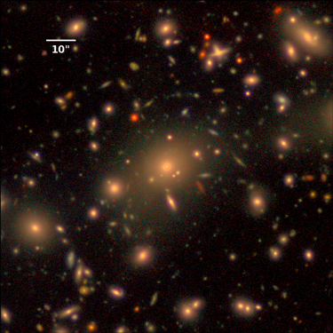
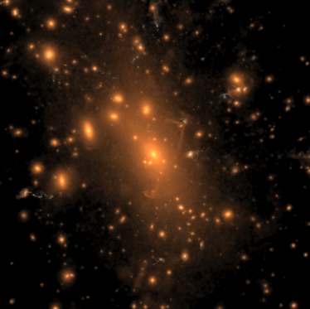



Stellar Profiles of Massive Galaxies:
Hyper Suprime-Cam Survey Hydrodynamic Simulations
vs.
Felipe Ardila
Alexie Leauthaud, Song Huang,
Benedikt Diemer, Annalisa Pillepich,
Ananth Tenneti,
HSC Collaboration, IllustrisTNG Collaboration
Notes:
Simulation: Stellar light distribution (rest-frame B,g,r band composites) of the most massive cluster in the simulation volume, at z=0.

Slide 2
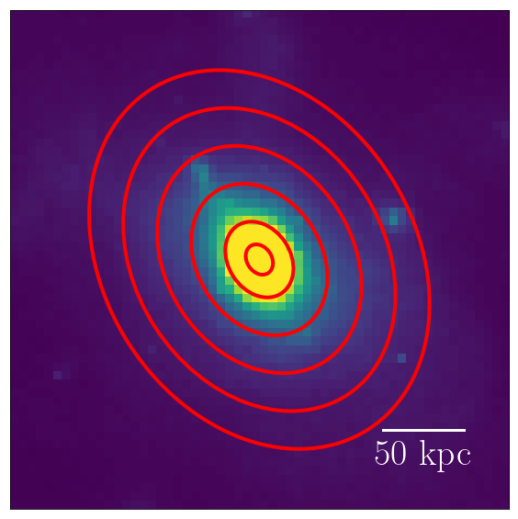
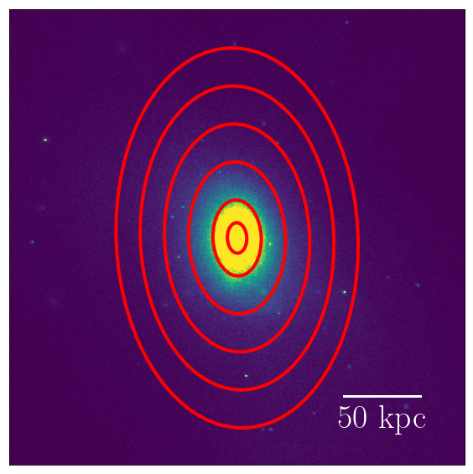
Observations
Hydrodynamic Simulations
HSC
Illustris
integrated light
stellar mass maps
Consistent methodology between observations and simulations
(Huang et al. 2018)
TNG100
Notes:
We want to do deatailed comparisons between these
We do things in a way that is consistent with how we do this in the data - Huang et al
We also have lensing
(I will of introduced these concepts earlier)

Slide 3
M_{★,100kpc} vs. M_{halo}
weak-lensing
Notes:
Explain that we can match Halo because we have the lensing

Slide 4
M_{★,100kpc} vs. M_{halo}
weak-lensing
Notes:
Explain that we can match Halo because we have the lensing

Slide 5
M_{★,100kpc} vs. M_{halo}
weak-lensing
Notes:
Explain that we can match Halo because we have the lensing

Slide 6
Matched by M_{halo}
Notes:
Show the profiles matched by Mhalo (with the inner parts fixed with the new high resolution maps)

Slide 7
Stellar Mass Functions

Slide 8


Main Takeaway:
Stellar profiles of massive galaxies: hydro simulations agree well with observations in inner regions, not so well (too much mass) in extended stellar envelopes
HSC
vs.
IllustrisTNG
Notes:
https://nl.pinterest.com/pin/514465957424466757/
http://inspirehep.net/record/1122490/plots

Slide 9

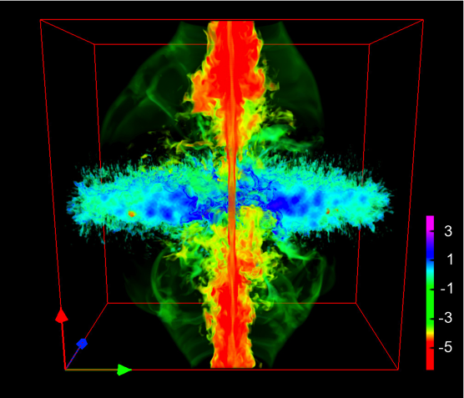
Takeaways:
Stellar profiles: hydro simulations matched well to observations in inner regions,
not so well in extended stellar envelopes
X-ray data: help calibrate the simulations further
baryonic effects
AGN feedback
vs.
Notes:
https://nl.pinterest.com/pin/514465957424466757/
http://inspirehep.net/record/1122490/plots

